Slide 1
CMP203 Graphics Programming
Revision and Billboarding

Slide 2
This week
Revision
Lighting
Camera
Billboarding
What is it
Why
How

Slide 3
Lighting
Major parts of lighting
Types of light source
Directions
Point
Spot
Light components
Ambient
Diffuse
Position/direction
Geometry needs normal
Advanced
Attenuation

Slide 4
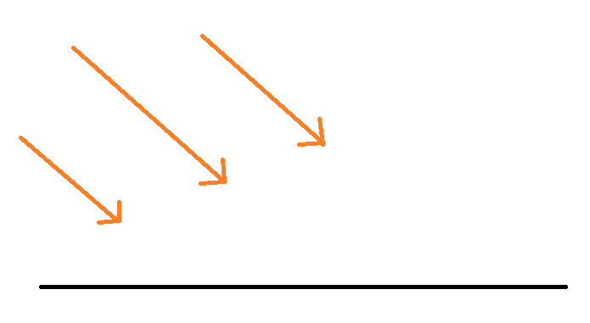
Lights
Directional
Position[ x, y, z, w ]
Position[ -1, 0, 0, 0 ]
W component will depict if light is a directional light or point light

Slide 5
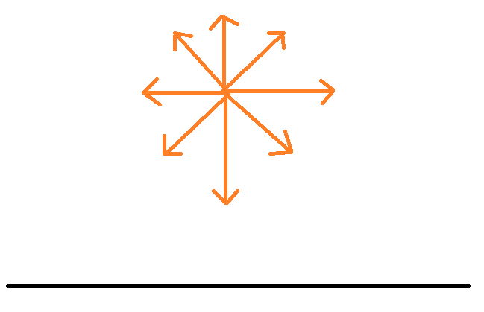
Lights
Point
Position[ x, y, z, w ]
Position[ 0, 1, 0, 1 ]
W component of 1 states point light

Slide 6
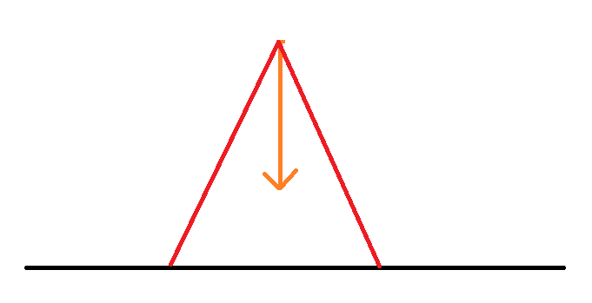
Lights
Spot
Position[ 0, 1, 0, 1 ]
GLfloat spot_direction[] = { 0.0, -1.0, 0.0 }
glLightfv(GL_LIGHT0, GL_SPOT_DIRECTION, spot_direction);
glLightf(GL_LIGHT1, GL_SPOT_CUTOFF, 45.0);

Slide 7
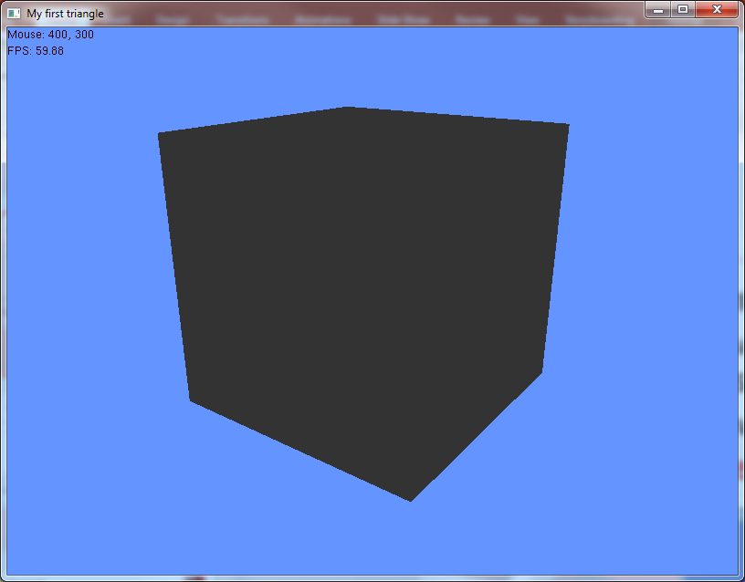
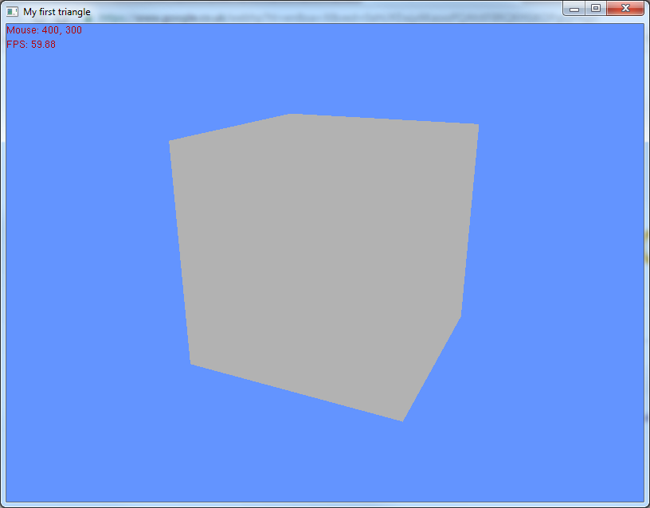
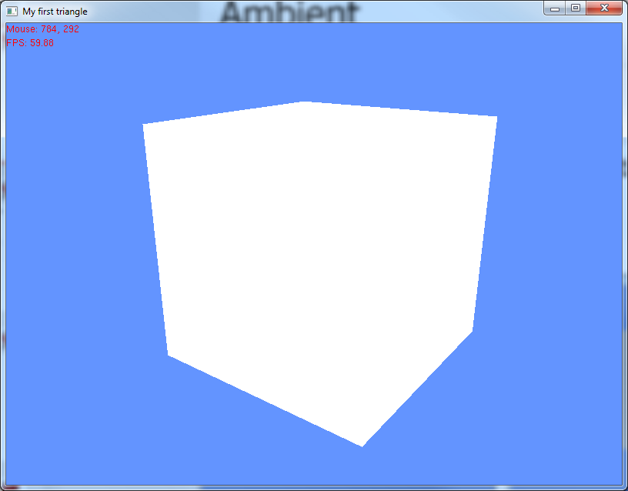
Ambient
Minimal level of lighting
Everything receives and equal amount of lighting regardless of position or direction
Usually a low power light
0%, 50%, 100% ambient

Slide 8
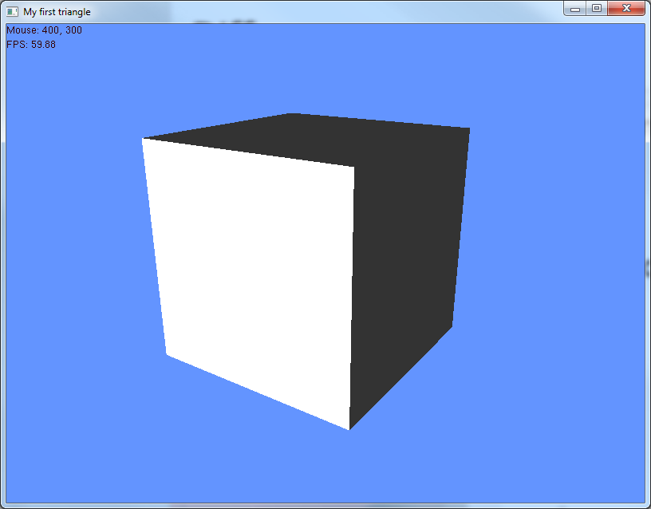
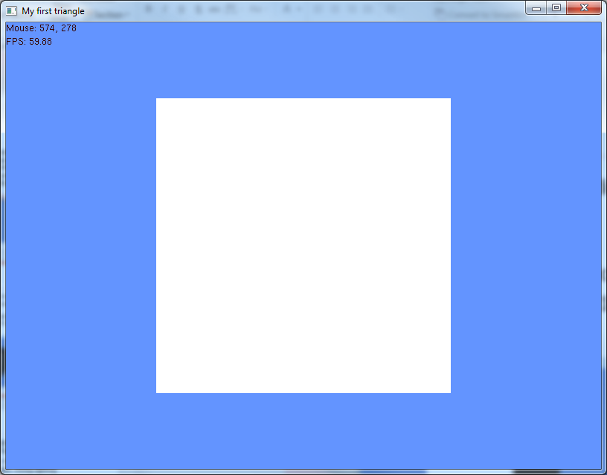
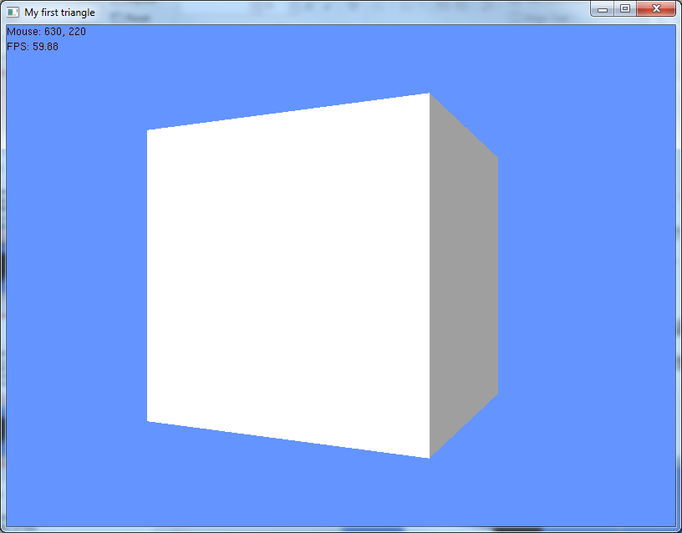
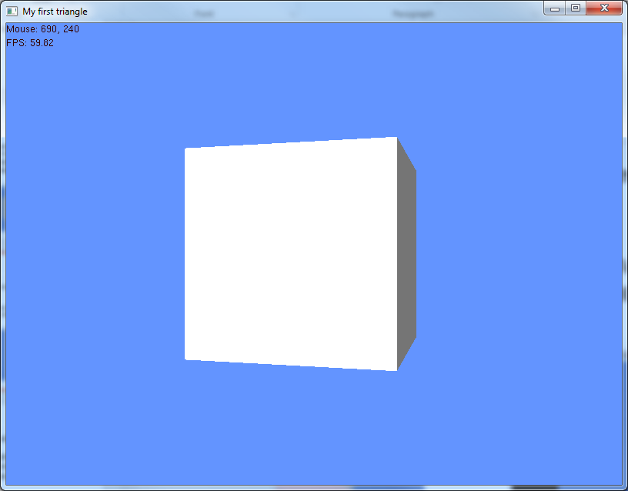
Diffuse
Light strength based on the direction the light hits the surface
Straight on more power
Brighter light
Determined by light position/direction and surface normals
Diffuse light along the z-axis 100%, rotate shape (no ambient)

Slide 9
Normals
Used in the lighting calculation to determine illumination of face
No normals, no lighting
Wrong normals, wrong lighting
Not enough normals, not enough lighting

Slide 10
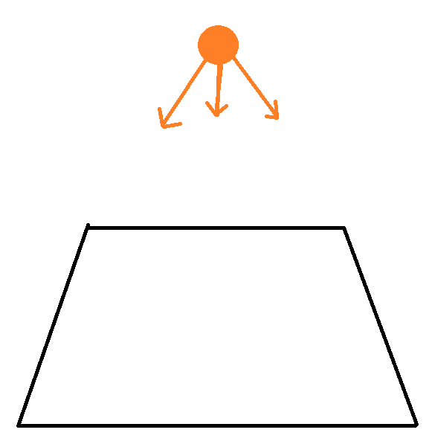

Slide 11
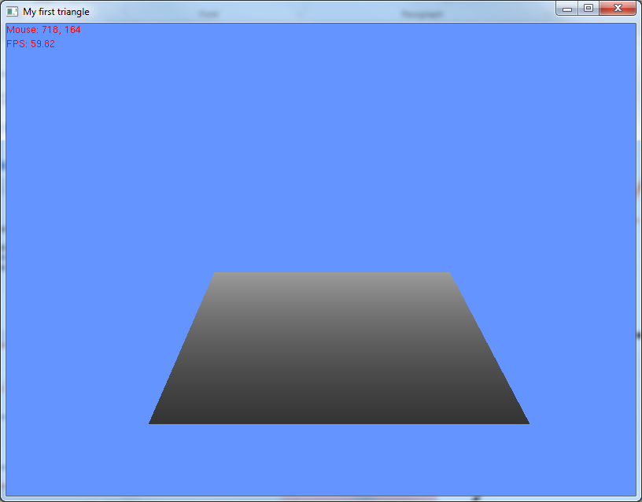

Slide 12
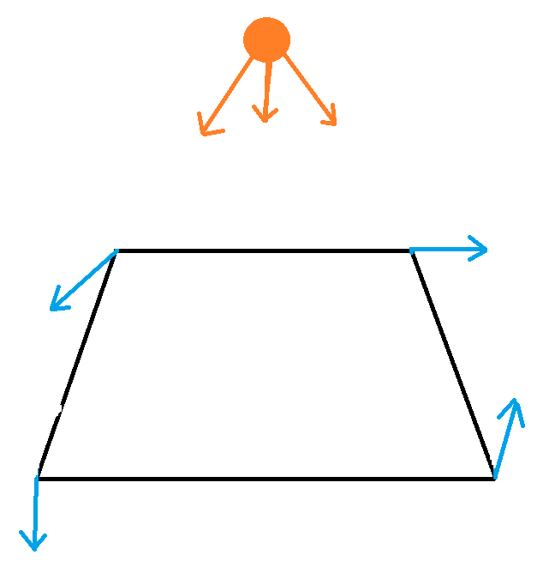

Slide 13
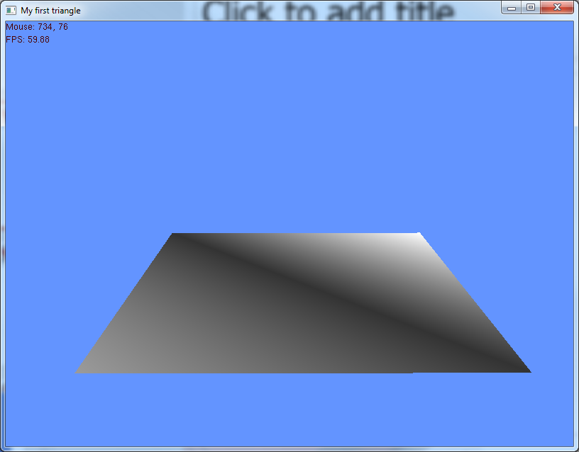

Slide 14
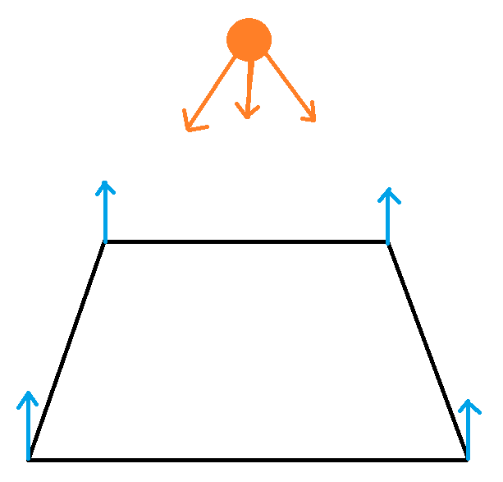

Slide 15
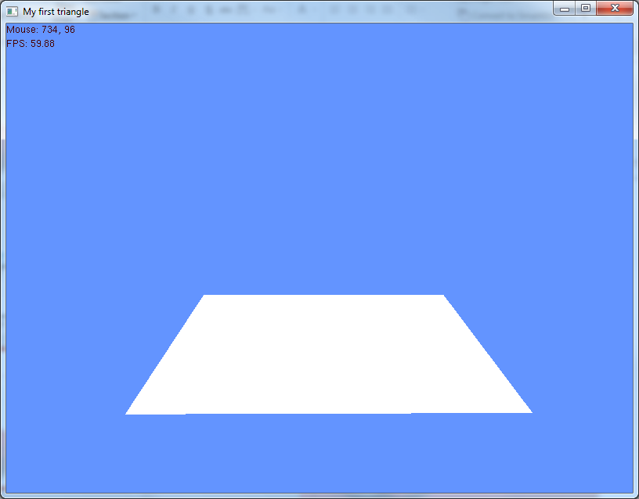

Slide 16
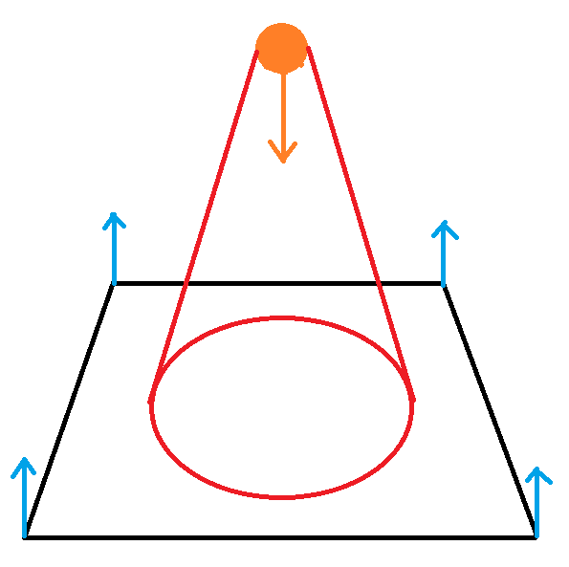

Slide 17
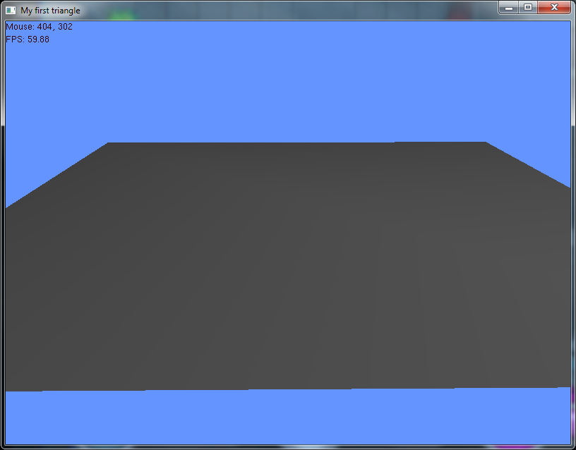

Slide 18
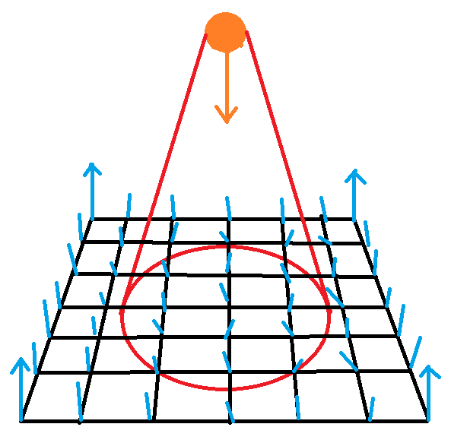

Slide 19
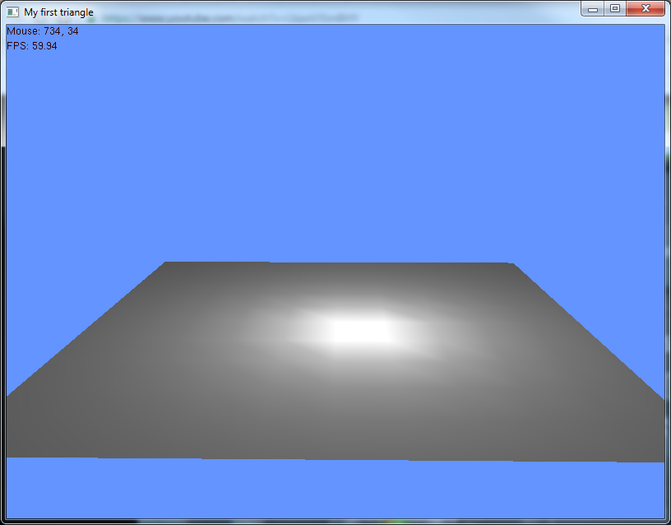

Slide 20
Basic Light setup
// lighting revision
GLfloat Light_Ambient[] = { 0.3f, 0.3f, 0.3f, 1.0f };
GLfloat Light_Diffuse[] = { 1.0f, 1.0f, 1.0f, 1.0f };
GLfloat Light_Position[] = { 0.0, 2.0, 0.0, 1.0 };
// Activate light
glLightfv(GL_LIGHT0, GL_AMBIENT, Light_Ambient);
glLightfv(GL_LIGHT0, GL_DIFFUSE, Light_Diffuse);
glLightfv(GL_LIGHT0, GL_POSITION, Light_Position);
glEnable(GL_LIGHT0);

Slide 21
Attenuation
Light falls off over distance
The further away, the less light
glLightf(GL_LIGHT0, GL_CONSTANT_ATTENUATION, 1.0);
glLightf(GL_LIGHT0, GL_LINEAR_ATTENUATION, 0.125);
glLightf(GL_LIGHT0, GL_QUADRATIC_ATTENUATION, 0.2);

Slide 22
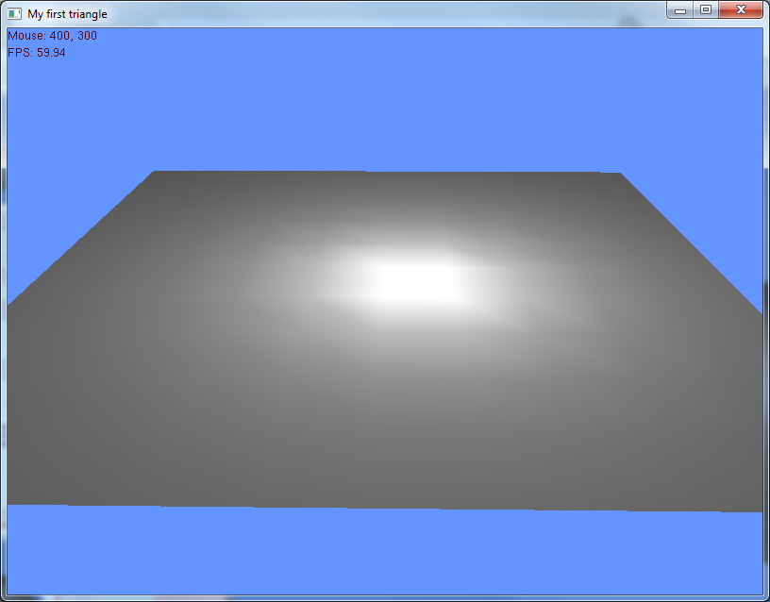
No attenuation

Slide 23
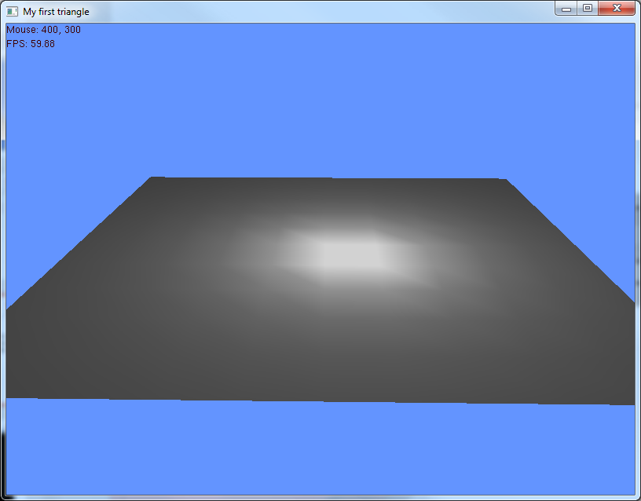
Low linear attenuation

Slide 24
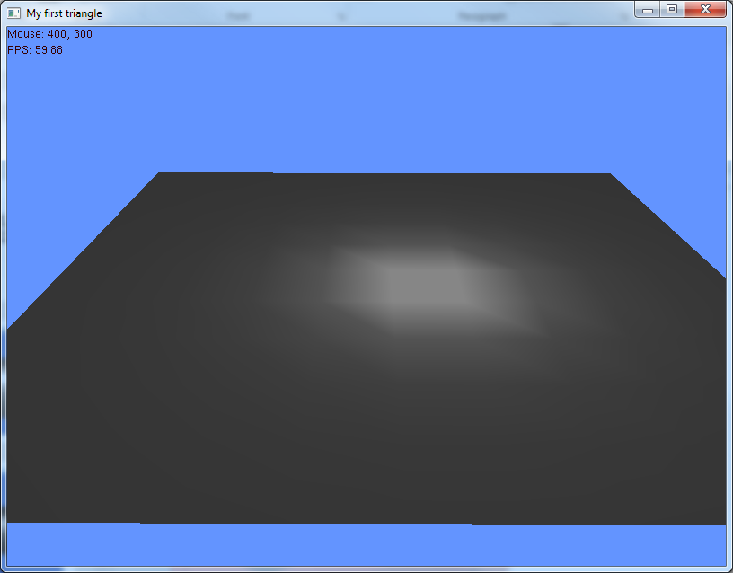
Some quadratic attenuation

Slide 25
Camera
Draw a diagram of the camera
Forward vector
Up vector
Calculate look at

Slide 26
Camera
Adding keyboard controls
Moving forward
Position = position + (forward * dt)
Vector class has an add function for doing this
Rotating
Increase/decrease yaw and pitch by 1.0f while key is pressed
Update camera

Slide 27
Camera
You were given the Camera.update() function
Need to add some functions; getters and setters, movement, rotation, etc
Get and set yaw/pitch/roll
Get and set position
Move forward/backward/strafe

Slide 28
Debug suggestions
When setting up the camera I highly recommend working with a single axis at a time
Start with rotating left and right
Then just up and down
Then both
This helps isolate bugs
Is easier to put in some magic numbers for testing purposes

Slide 29
Billboarding
A technique to orientate objects/geometry to “face” a target
The target is usually the camera
But can be any position in 3D space
Major advantage billboarding can be used to reduce the number of polygons for certain objects / models
Replacing the complex model with a billboarded imposter model
Example
Full 3D tree model, many, many polygons
Simple imposter version is a single quad
The quad rotates to always face the player/camera
Hard to tell the model is a simple quad

Slide 30
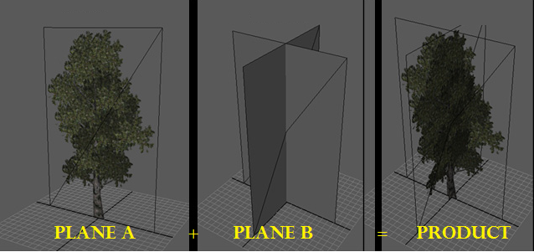
Billboarding

Slide 31
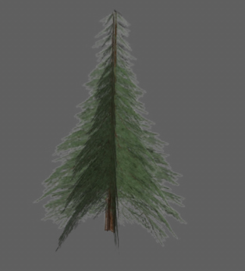
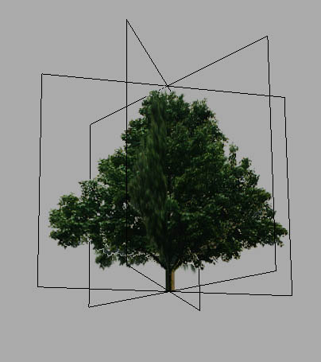
Billboarding

Slide 32
Billboarding
Two forms of billboarding
Cylindrical
Restricted to a vector (usually the Y-axis)
Spherical
No restriction on orientation

Slide 33
Cylindrical
Create a vector from the object to the camera
Camera Position – object position
For cylindrical we restrict the rotation, therefore, the above vector y component is set to zero
Using the objects forward vector (usually the same as the objects normals)
Objects fixed up vector (0,1,0)
You can calculate the angle between the forward vector and the object-to-camera vector
It is also wise to do a cross product of these two vectors in case of a negative angle
The cross product should match the up vector for positive angle
And be opposed to the up vector for negative

Slide 34
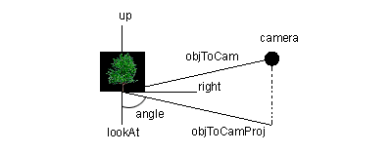
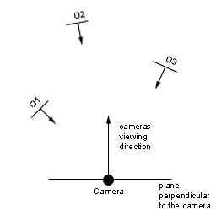
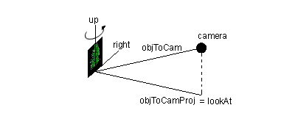
Billboarding

Slide 35
Spherical
Is an extension of cylindrical
Do cylindrical billboarding then rotate the object until it is properly facing the camera/target
Can calculate the angle based on the real object to camera vector and the version with a y-component of zero

Slide 36
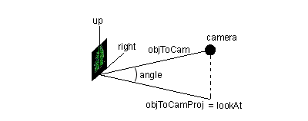
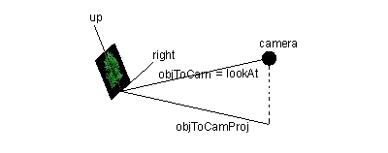
Spherical

Slide 37
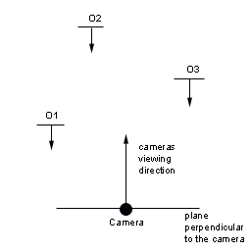
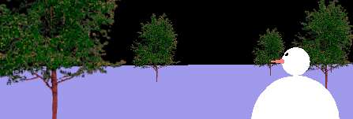
Billboarding
If you are very lazy
Instead of every object having it’s own rotation
They all get the same rotation
Can be hard to tell they aren’t 100% billboarded

Slide 38
End of line
Labs
Catch up and coursework
Coursework
Demonstration timetable on Blackboard
Enjoy the holidays ☺

Slide 39
